Slide 1
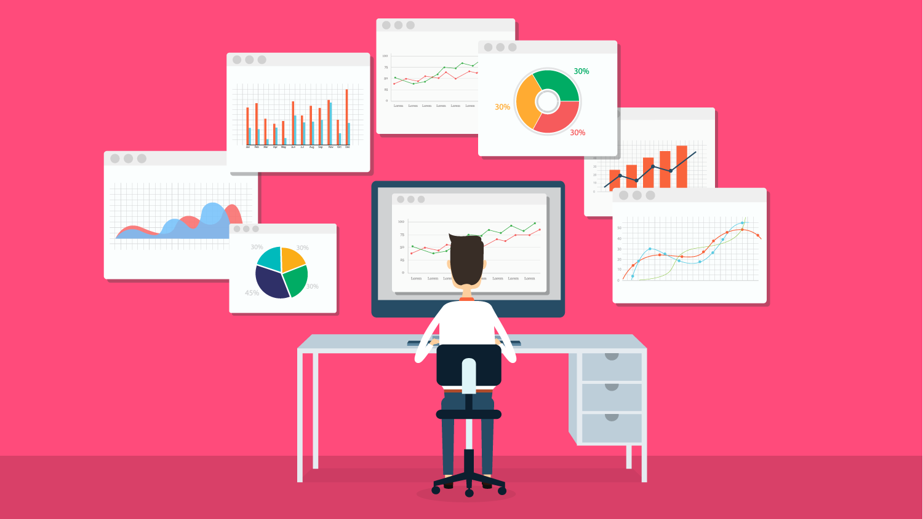
Data driven Marketing strategy
Customers’ journey on a website

Slide 2
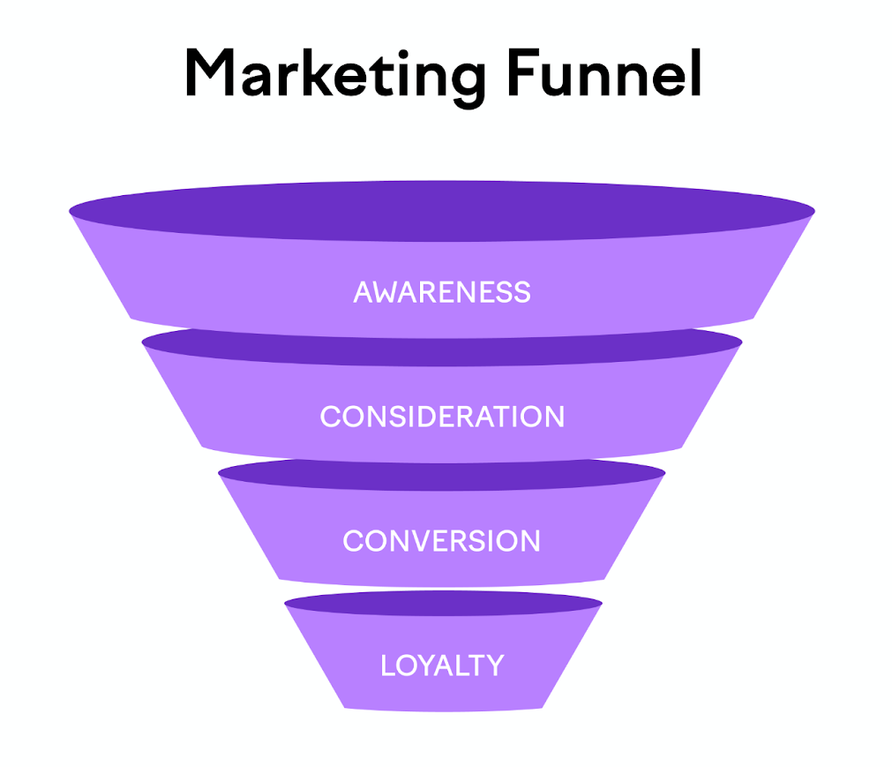
Customer Marketing Funnel
Basic marketing funnel has 4 phases.
Awareness: Cutomer visits the listing or product page
Consideration: Product is added to cart
Conversion: Decision step where product is purchased
Loyality: Repeated purchases

Slide 3
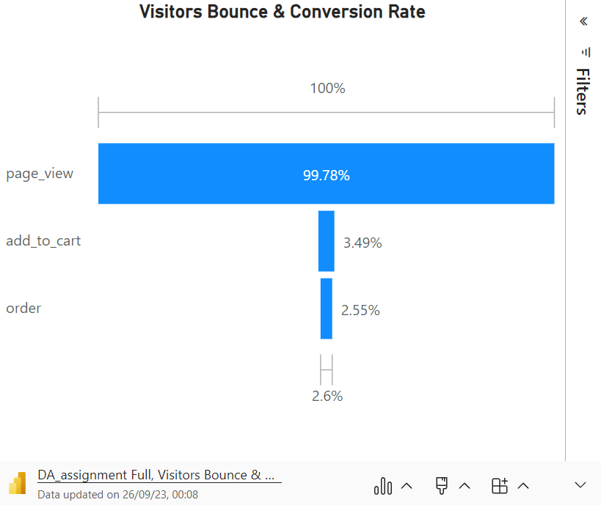
Customer Purchase Funnel
Key Matrices are:
Website traffic (total visitors)
Bounce rate (only viewed pages)
ACR (add to cart rate)
Conversion rate (purchasing rate)
Here conversion rate from page_view to add_to_cart is only 3.5% while from add_to_cart to order almost 73%

Slide 4
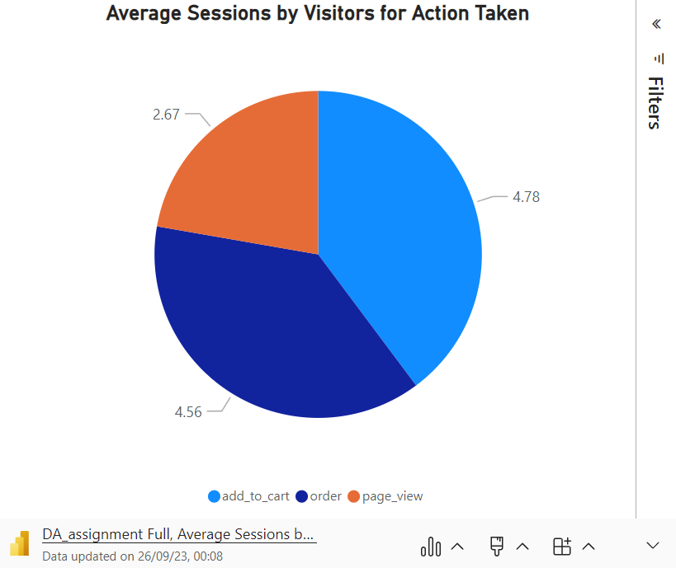
Time Spent On Website
Visitors with more sessions to order page ended up purchasing the product.

Slide 5
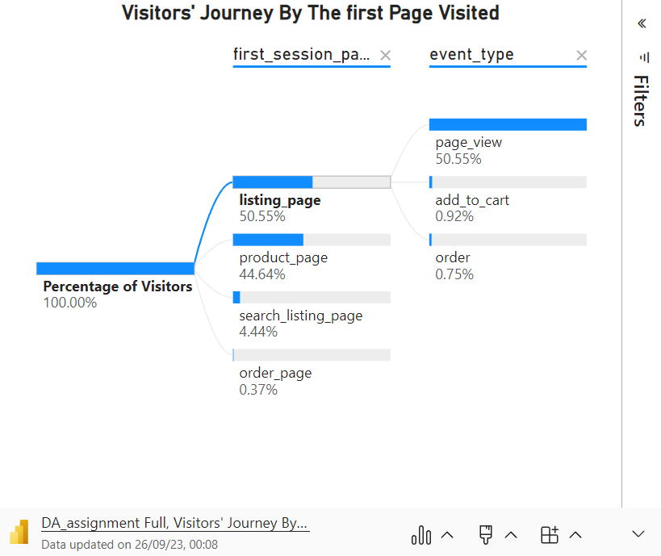
Journey By Landing Page Type
Visitors’ journey is varied by the first page they visited.
Data shows that visitors whose first age was product_page are most likely to perform the add_to_cart or order action where as whose first age was search_listing_page are least likely to perform these actions.

Slide 6
Additional Information Needed
Follwing additional information would be needed to understand the effectiveness of the current strategy:
Product types
Pricing range of products
Demographics of the visitors (age, gender, location, etc.)
Time spent by visitor on each session and page

